Slide 1

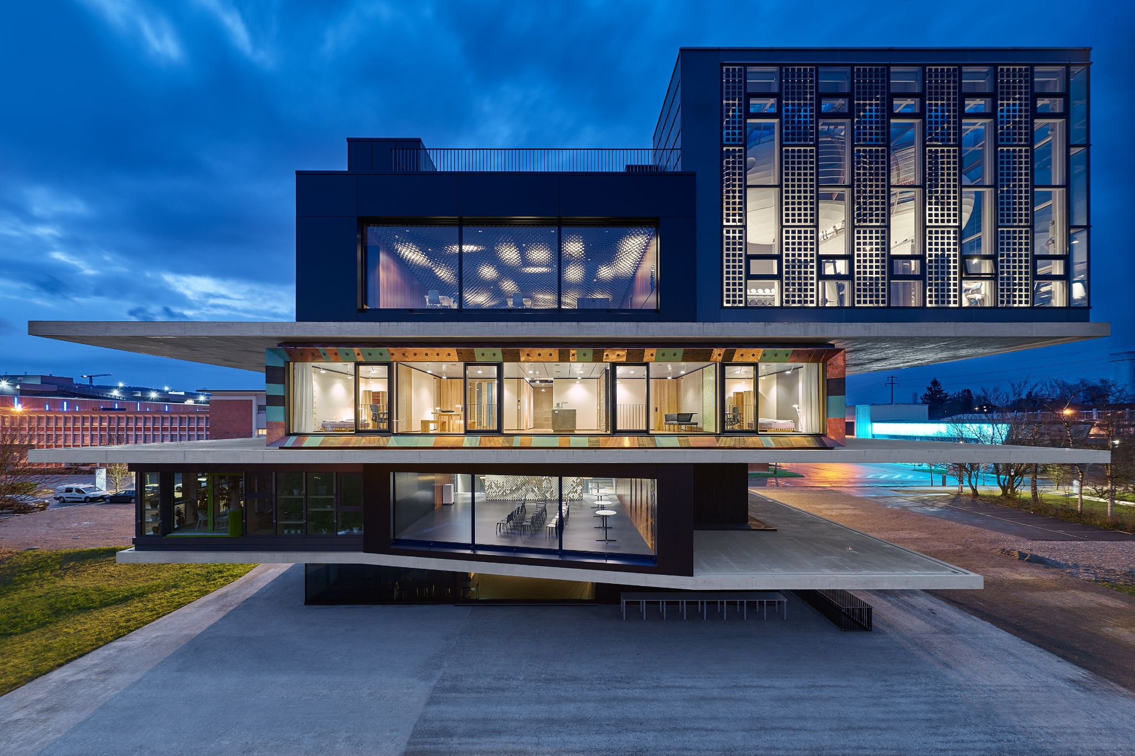
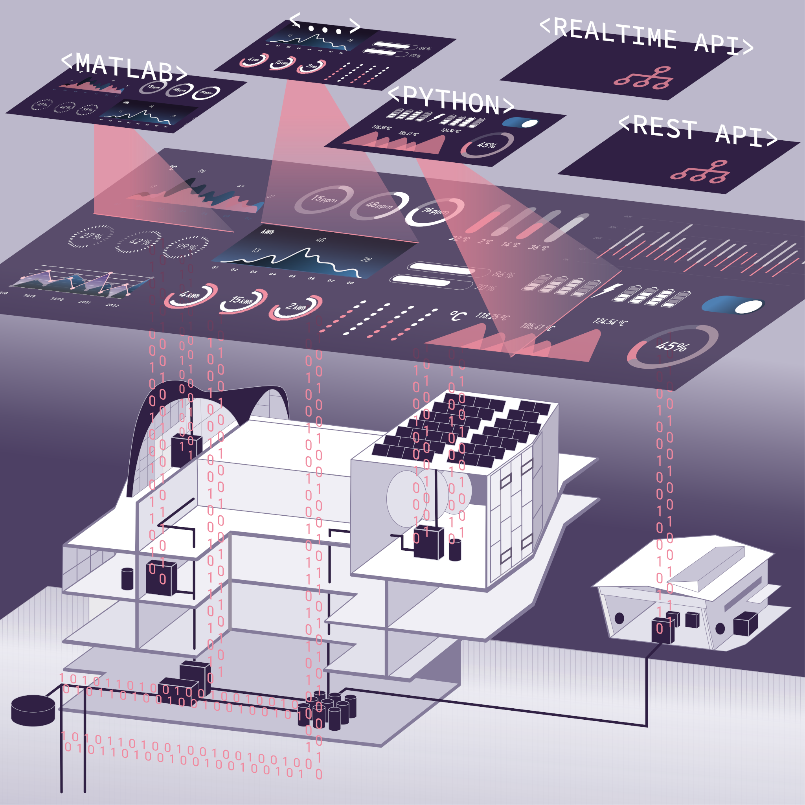
Challenge Nr 4
NEST, a Data-driven Building Model
Use the rich measurement data from NEST for prospective uses in digitalization and energy efficiency
© Zooey Braun, Stuttgart

Slide 2
The topic:
Although buildings account for almost half of Switzerland's total final energy consumption, digitalization in the building sector is not yet very advanced.
At the Empa NEST demonstrator, new technologies and algorithms are being developed and tested. For this purpose, NEST is monitored in detail by some 10’000 sensors.
The aim of this challenge is to use the rich measurement data from NEST towards improving sustainability and energy efficiency by digitalization.

Slide 3
Challenge
The overall objective is to investigate the dependencies between the current energy input, indoor climate and weather, and the indoor climate at a later point in time. The corresponding question is: Which energy input leads to which future indoor climate for a given initial situation (current indoor climate, weather)?
Participants can choose their own approach or they can use the following, more detailed objectives and questions as a guide.

Slide 4
Possible approaches:
1) Visualization of the interrelationships:
Which energy input leads to which indoor temperature?
How delayed is the reaction of the indoor temperature to a change in the energy input (i.e. how great is the thermal inertia)?
What influence do boundary conditions such as the outside temperature or the current indoor climate have on the subsequent indoor climate?
Do the above relationships vary between different rooms? Methodological note: H-scatterplots or cross-correlograms, among others, are suitable for the explorative investigation of "lagged correlations".

Slide 5
Possible approaches:
2) Statistical modelling of the correlations from 1):
Can these correlations be quantified with a statistical model?
Do the correlations become clearer if not only the current measurements are used as predictors, but also the last N historical measurements?
3) Sensors are expensive. In the real situation, there are usually fewer sensors available:
Which sensors (predictors) have which significance in the model from 2)?
Can the model be reduced by individual sensors to save costs without the prediction of future room temperature suffering greatly?

Slide 6
Resources / Data
The participants are provided with the data from the scientific study in an adjusted form, as CSV.
https://figshare.com/projects/NEST_Open_Building_Data_for_Energy_Demand_and_User_Behaviour/101714
An overview of the measurement data and infrastructure at NEST is available at the following link: https://info.nestcollaboration.ch/wikipediapublic/.
The measurement data of the NEST research building can be accessed via REST API.
A detailed description of the sensors (incl. costs) is provided.
A Graphana dashboard provides visual access to all relevant measurement data.
Contact: philipp.heer@empa.ch
Additional measurement data, such as outdoor temperature or solar radiation, can be obtained via publicly accessible interfaces.
Literature: Bünning, F., Huber, B., Heer, P., Aboudonia, A. and Lygeros, J., 2020. Experimental demonstration of data predictive control for energy optimization and thermal comfort in buildings. Energy and Buildings, 211, p.109792.
More info: https://www.empa.ch/web/energy-hub/ehub-platform
https://www.empa.ch/de/web/nest/

